Slide 1
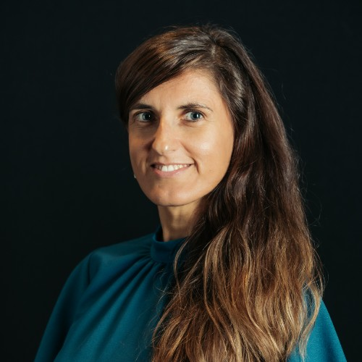



Impactful and Future-Proof Research
Julia PALMA
CeADAR
Programme Manager
julia.palma@ucd.ie
CyclOps WINTER SCHOOL
Bolzano, 13 January 2026
Views and opinions expressed are however those of the author(s) only and do not necessarily reflect those of the European Union or the European Commission as the granting authority. Neither the European Union nor the granting authority can be held responsible for them

Slide 2
Why Care About Impact?

Slide 3



Julia Palma
julia.palma@ucd.ie
Why Impact is Now Non-Negotiable
CORE FUNDING CRITERION
MANDATORY AND OUR RESPONSIBILITY AS RESEARCHERS
LONG-TERM RESEARCH RELEVANCE
AND CAREER IMPACT
Not only for innovation programmes, also research funding programmes want to see the potential generated impact (e.g. Research Ireland)

Slide 4






Julia Palma
julia.palma@ucd.ie
Outsourcing Your Impact Section:
A Big Mistake
Impact is not marketing; it’s a research activity.
Writing it yourself shows you understand:
Who benefits and how
Barriers and risks
Credible pathways to outcomes
Generic or outsourced text is prone to gaps or inconsistencies and undermines credibility with evaluators.
If your impact section is vague or copied from templates, risks and assumptions may not align with your methodology
Defining Impact is like designing an experiment for the future: you know best the assumptions and evidence.

Slide 5

Julia Palma
julia.palma@ucd.ie
Why you must own the Impact
Career & Funding Impact
Builds skills for:
- future (continuation) proposals
- collaborations with industry and other stakeholders
- policy engagement
Evaluators reward researchers who understand the societal, economic, and policy impact
Opens opportunities for jobs beyond Academia
Credibility
Assumptions align with methodology
Pathways to impact are realistic and evidence-based
Practical Advice:
Treat impact like an experiment: collect evidence, identify pathways, test assumptions
Use logic maps or stakeholder analysis to structure your thinking
Reach out for support and consult advisors, but define the main points yourself

Slide 6
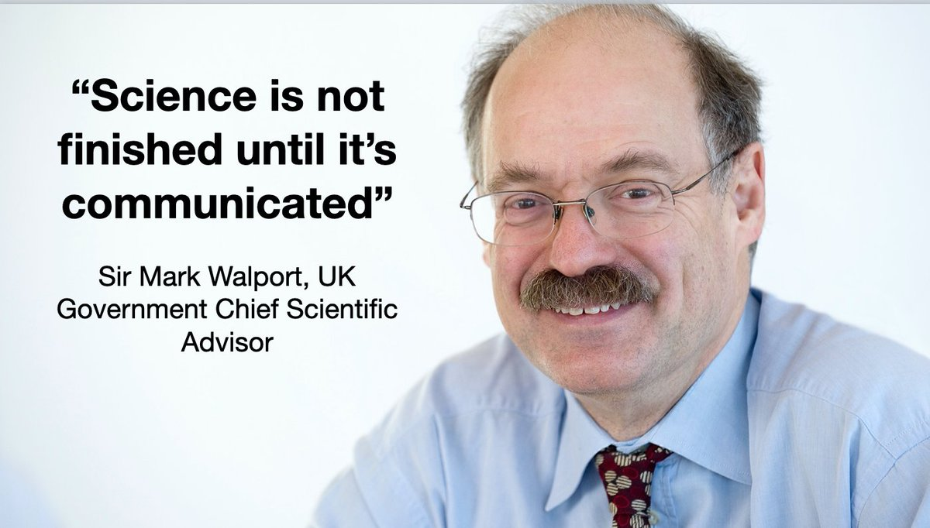
Julia Palma
julia.palma@ucd.ie

Slide 7
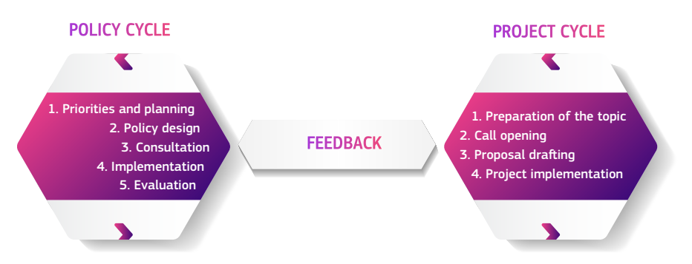
Julia Palma
julia.palma@ucd.ie
Policy Contributions as part of your Research
Special Eurobarometer 557:
68% of Europeans agree that scientists should intervene in political debate to ensure decisions take into account scientific evidence.
Source: Sharing scientific evidence with policy makers. A starter kit for EU-funded research and innovation projects (European Commission, 2025, DOI 10.2848/8625431)

Slide 8
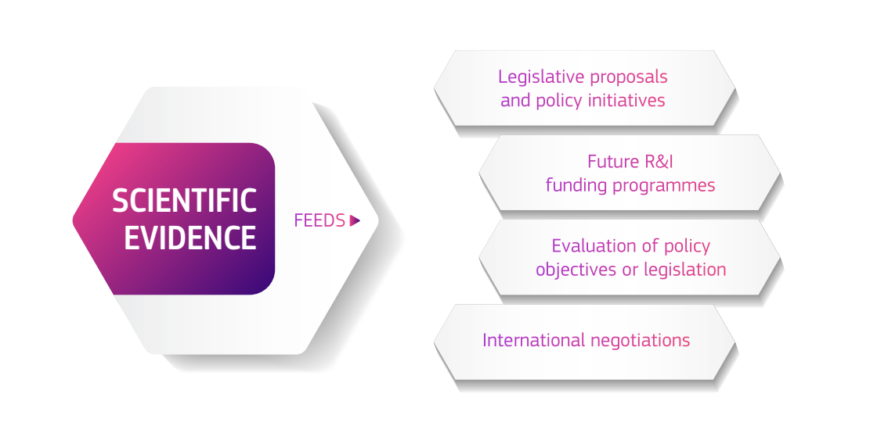
Julia Palma
julia.palma@ucd.ie
The Virtuous Cycle of Research Impact
Source: Sharing scientific evidence with policy makers. A starter kit for EU-funded research and innovation projects (European Commission, 2025, DOI 10.2848/8625431)

Slide 9
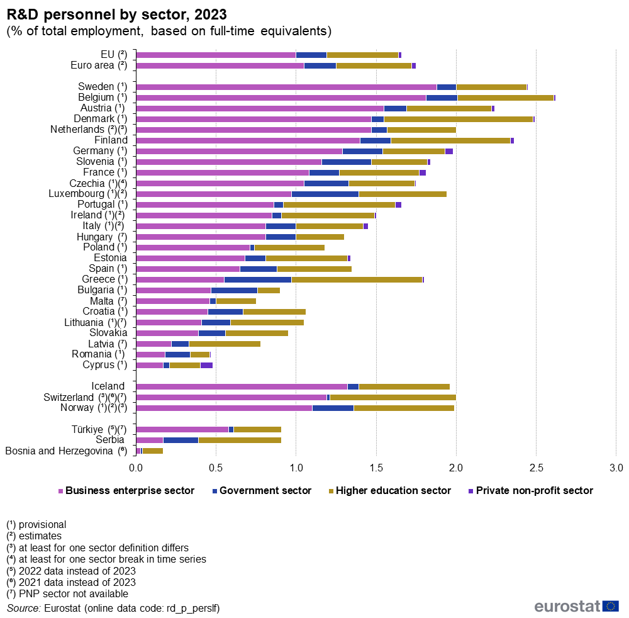
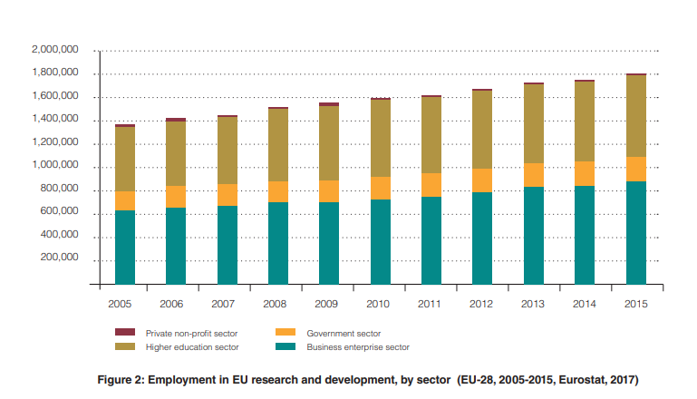
Julia Palma
julia.palma@ucd.ie
Why Impact Matters
for Researchers
65% Increase in number of FTE Researchers in EU between 2005 and 2023 (from 1.30 to 2.15 million).
FTE Researchers in the EU in 2023
57% worked in Business Enterprises
32% in Higher Education (HE)
10% in the Government sector
Source: Eurostat (online data code rd_p_perslf)

Slide 10
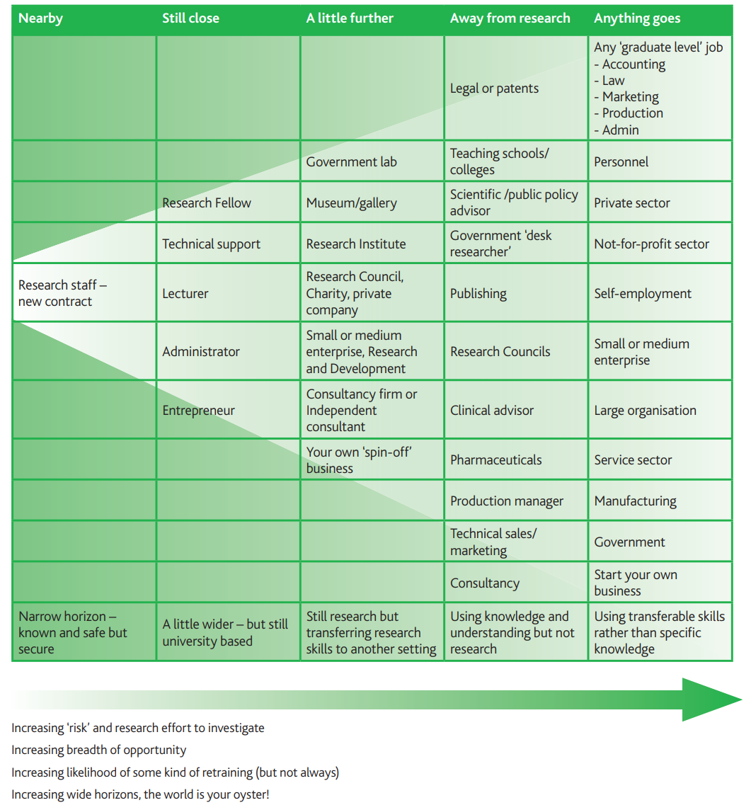
Julia Palma
julia.palma@ucd.ie
Widening Horizons
Researchers’ transferable skills open multiple opportunities within and beyond HE
Source: Vitae, 2013 The Career-Wise Researcher

Slide 11
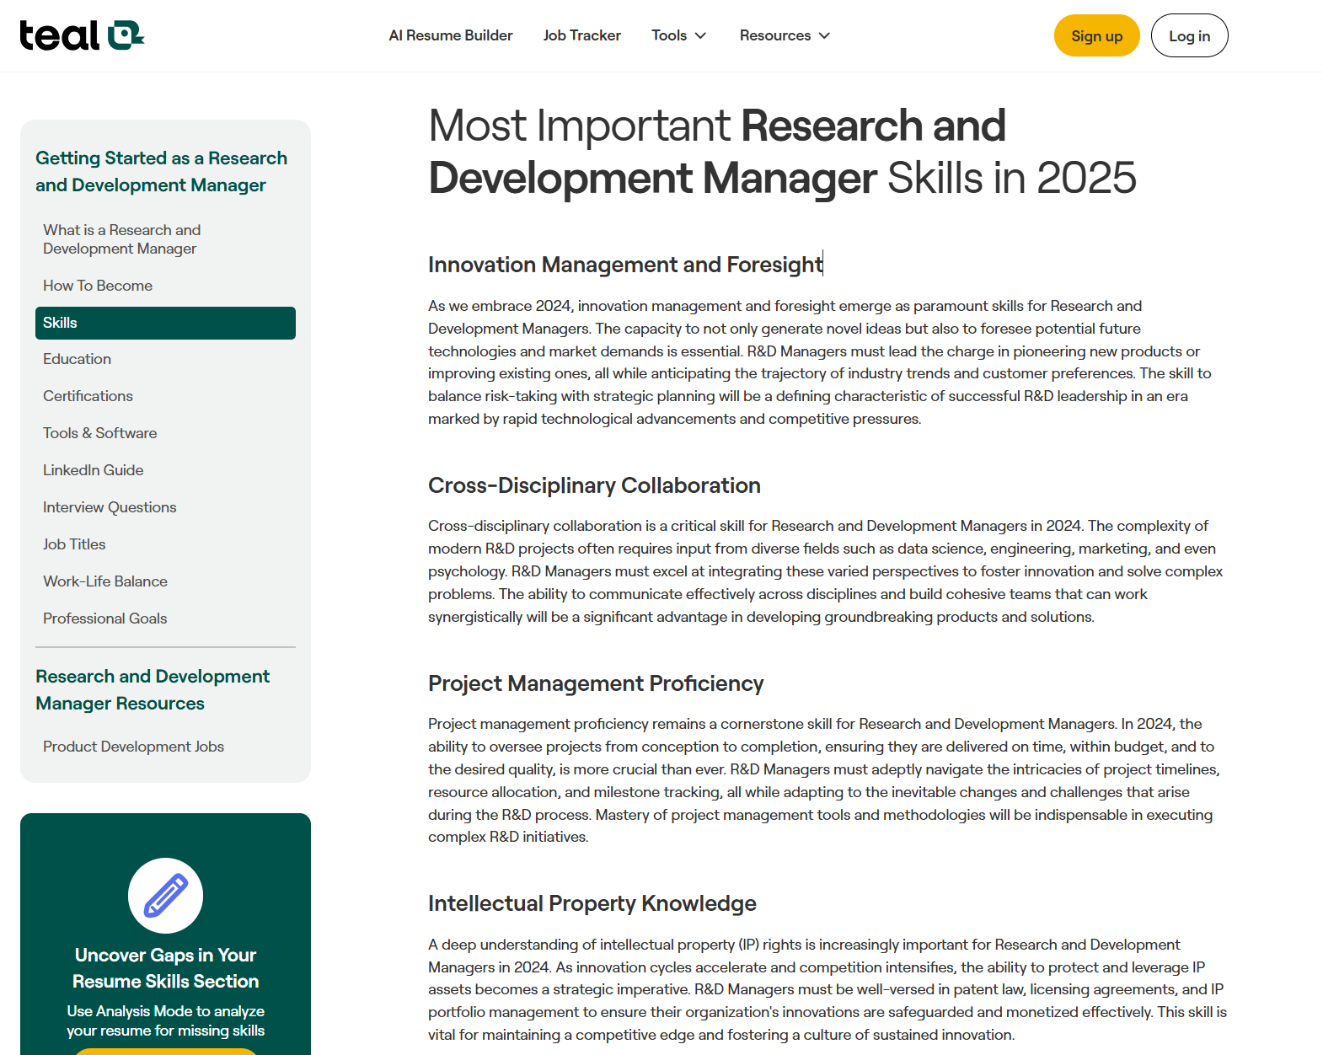


Julia Palma
julia.palma@ucd.ie
Why Impact Matters
for Researchers
Innovation Management and Foresight
(Future Technologies and Market Demand)
Cross-Disciplinary Collaboration
PM Proficiency
Intellectual Property Management
Resourcefulness and Budgeting Acumen
Regulatory Compliance and QA
Strategic Thinking
Environmental and Social Governance (ESG)
Source: Teal (https://www.tealhq.com/skills/research-and-development-manager)

Slide 12





Julia Palma
julia.palma@ucd.ie
Why Impact Matters for Researchers
HIGHER GRANT SUCCESS RATES
STRONGER PROMOTION & TENURE CASES
INCREASED VISIBILITY & LEADERSHIP OPPORTUNITIES
EXPANDED INTERNATIONAL AND INDUSTRY NETWORKS
CAREER RESILIENCE IN A VOLATILE FUNDING LANDSCAPE

Slide 13
More competitive proposals
Clearer narratives, higher evaluation scores
Clearer alignment with funder priorities
Proposals speak the funder’s language and help shape it
Contributions to work programme drafts & consultations
Institutions with strong impact insight influence future funding calls
Enhanced institutional reputation
Recognition for delivering meaningful results
Deeper partnerships
Trusted relationships with funders, industry & policy stakeholders
Sustainable funding pipelines
Long-term success across calls and programmes
Why Impact Matters for
Research Managers and Administrators
The “Impact Partner” Advantage
More invitations • More strategic roles • More influence

Slide 14

Julia Palma
julia.palma@ucd.ie
Impact as Career Insurance
Impact as Career Insurance Researchers and institutions that embed impact:
Adapt faster to new funding priorities
Survive policy shifts and budget constraints
Remain fundable and relevant
Build long-term trust with funders and partners
Researchers and Institutions that embed Impact:
Adapt faster to new funding priorities
Survive policy shifts and budget constraints
Remain fundable and relevant
Build long-term trust with funders and partners

Slide 15
Impact in EU Projects Learning to Love the "Dreaded" Section 2 in Horizon Europe Proposals

Slide 16
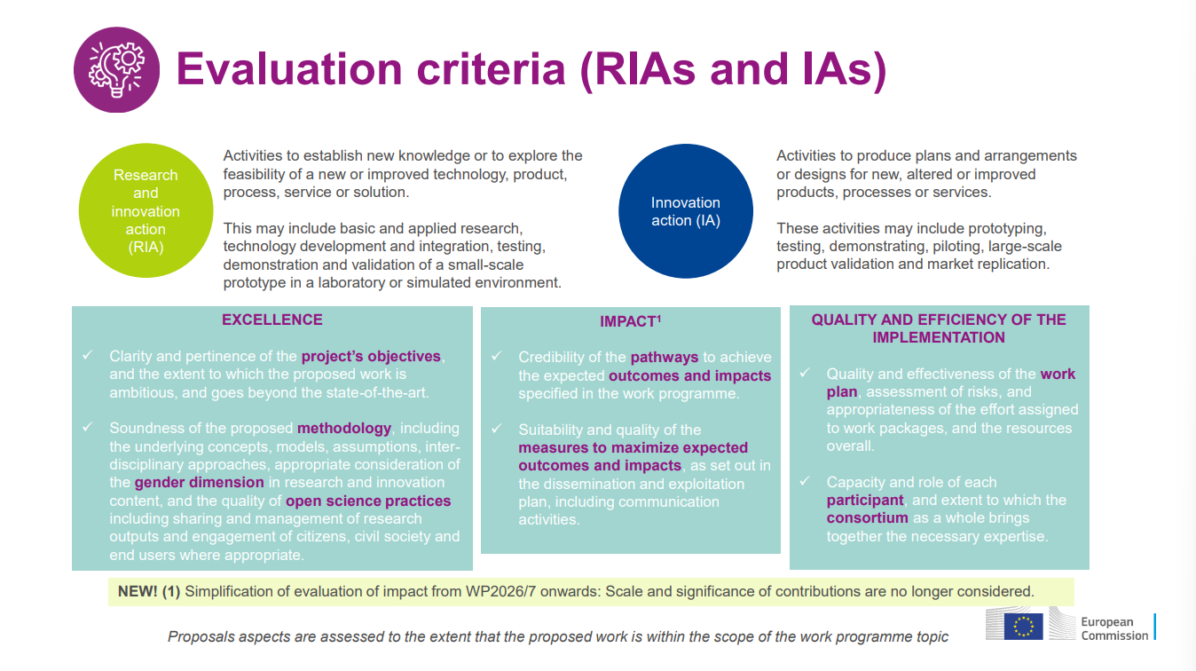
Source: European Commission, Horizon Europe Proposal Evaluation Standard Briefing (2025), Version 13.0

Slide 17
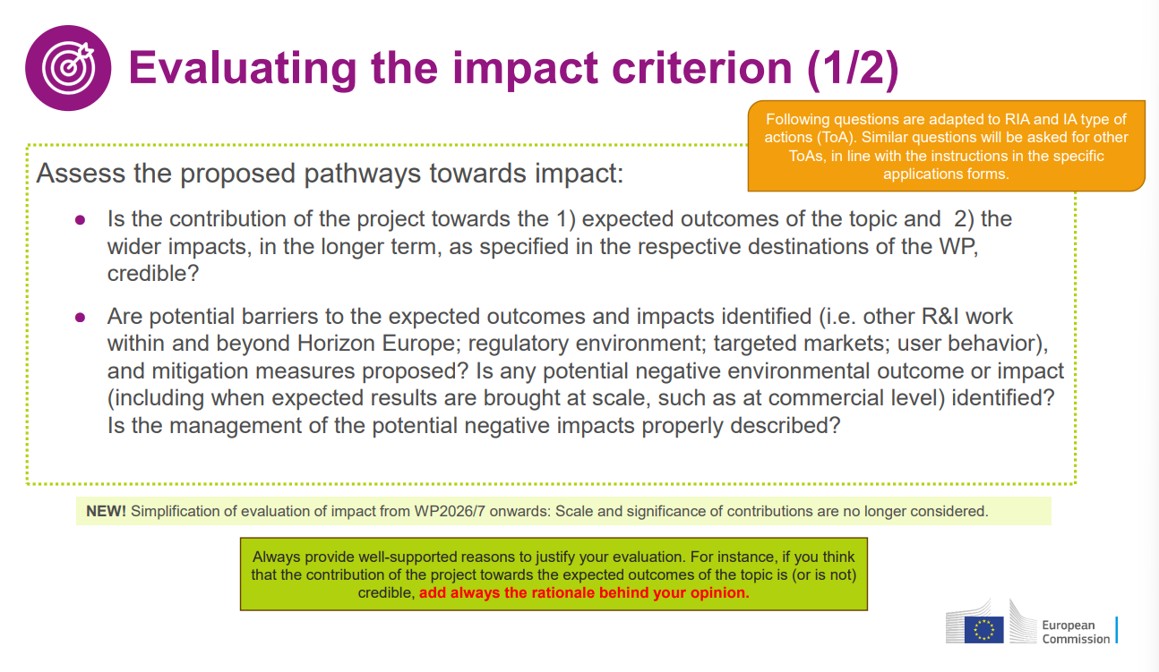
Source: European Commission, Horizon Europe Proposal Evaluation Standard Briefing (2025), Version 13.0

Slide 18
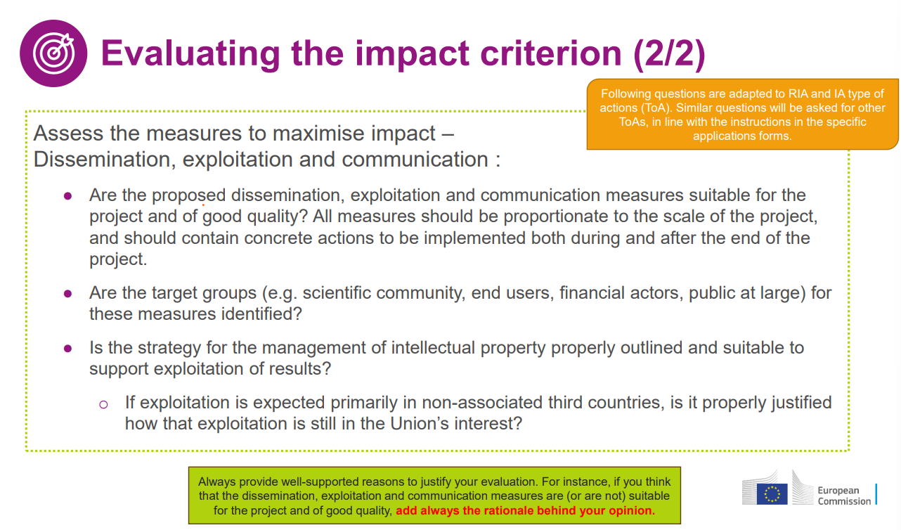
Source: European Commission, Horizon Europe Proposal Evaluation Standard Briefing (2025), Version 13.0

Slide 19
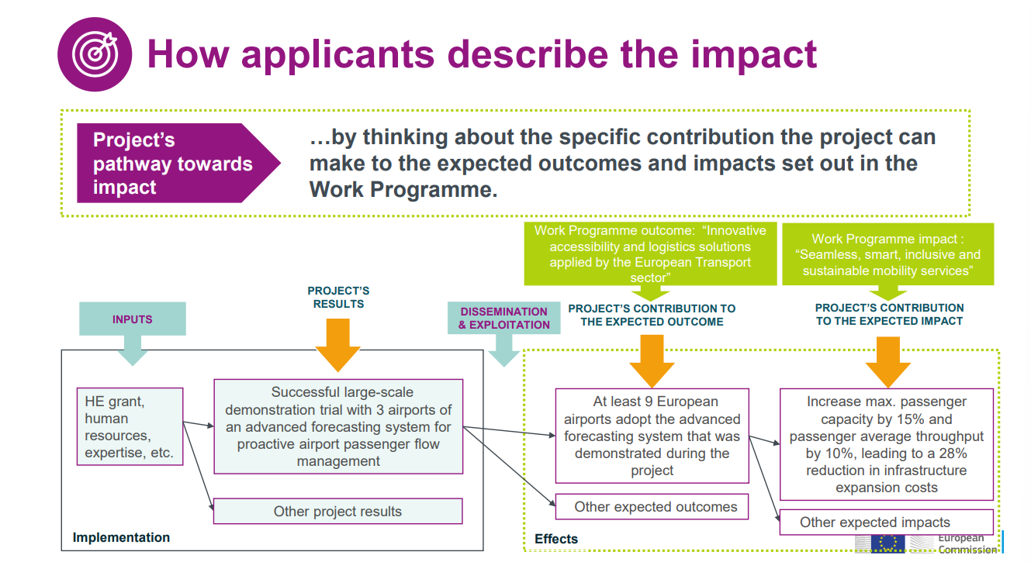
Source: European Commission, Horizon Europe Proposal Evaluation Standard Briefing (2025), Version 13.0

Slide 20
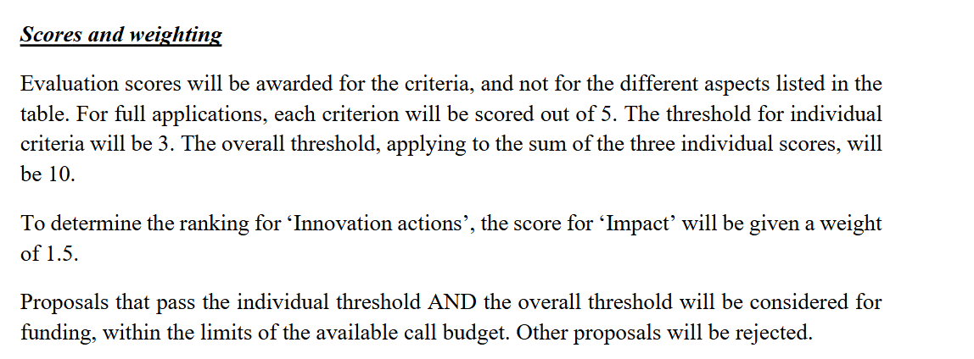
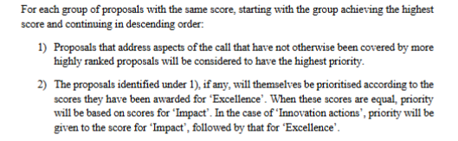
Impact is 1/3 of the Score (at least!)
Source: Horizon Europe Work Programme 2026-202715. General Annexes (European Commission Decision C(2025) 8493 of 11 December 2025)

Slide 21
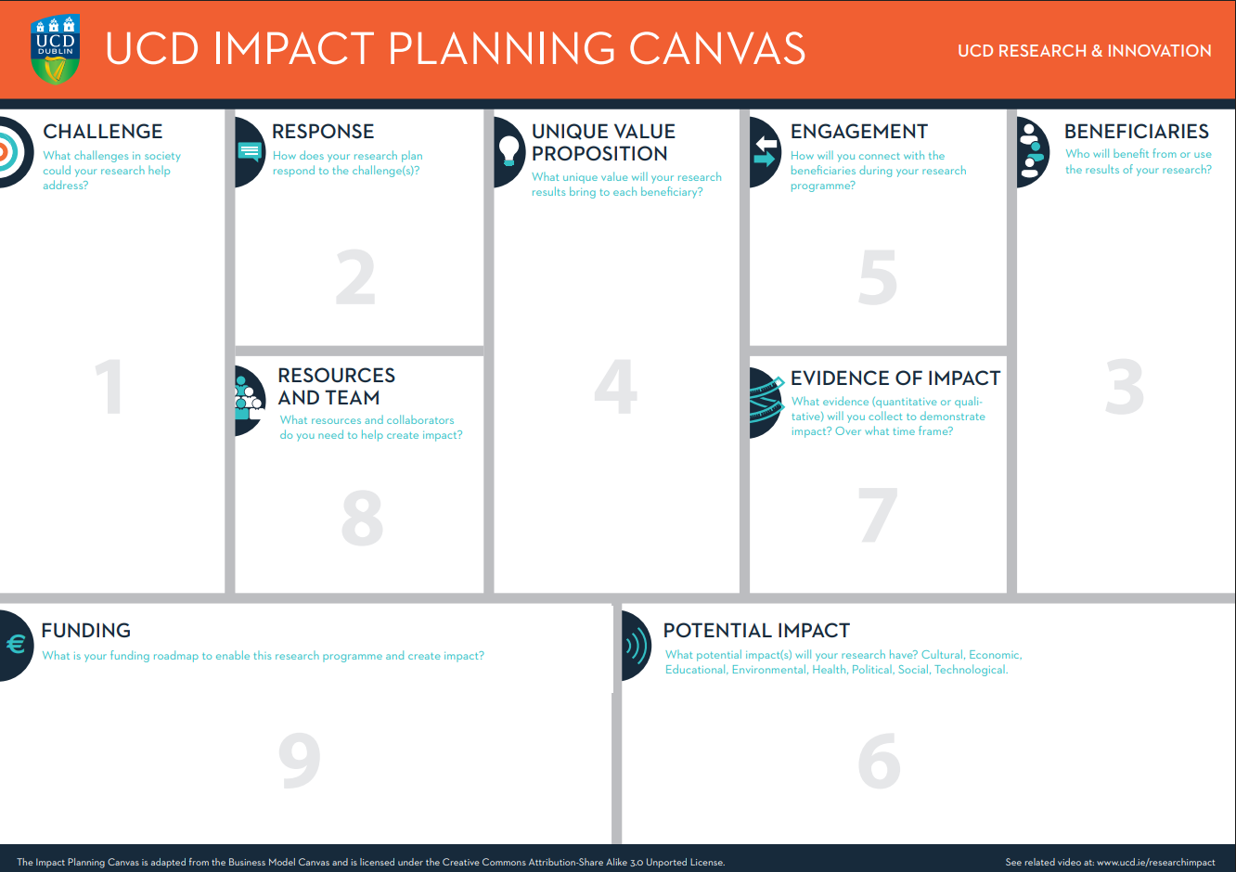
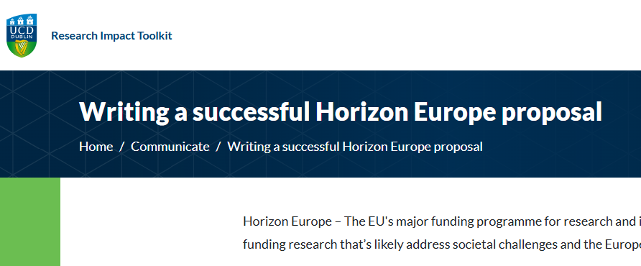
UCD Resources
Source: UCD webpage https://www.ucd.ie/impacttoolkit/communicate/writingasuccessfulhorizoneuropeproposal/

Slide 22
Using the Logic Map
Julia Palma
julia.palma@ucd.ie
Start with Why?
Expected Outcomes and Impact
- Those defined in Topic Description
- Be creative and bold
Section 2!!!
1
Why Not Yet?
Analyse Challenges and current solutions (SotA)
Section 1
2
How?
Identify solutions to the challenges and how to measure success
Mechanisms: Methodology
(Section 1)
and Activities: WP (Section 3)
4
What?
Draft Objectives accordingly
Section 1
5
With Whom?
Pathway to Impact: Infrastructure, Stakeholders and Networks and how to reach out to them
Section 2
3
LLMs to parse candidates
Human-oversight

Slide 23
Challenges
Objectives
Outcomes / Results
Pathway to Impact
Expected impact
O1
R1
For citizens
Vertical-based:
C1
P1
Application 1 xxx
Application 2 xxx
O2
C2
R2
P2
For the research community
C3
O3
R3
P3
C4
R4
C5
O4
P4
For SMEs
O5
R5
R6
P5
For decision-makers
O6
C6
R7
P6

Slide 24

Logic Map Example
Julia Palma
julia.palma@ucd.ie
1
2
3
4
5
Com
Why?
Companies want to leverage the value of data they have or may access (e.g. data spaces)
Why Not Yet?
Lack of agnostic, low-literacy, low-cost, accesible AI tools for small businesses
Available solutions require either big investment without clear ROI or specialist talent
With Whom?
Industry partners (SMEs) in the Project, RTO, technology providers, technological consultancy companies not linked to specific tech stack
How?
Identify bottlenecks in the data processing workflow and develop tools for each and every step.
Two iterations of development of modular tools
What?
Integrated platform
Interoperable modules covering the data pipeline processes
LLMs to parse candidates
Human-oversight

Slide 25
Julia Palma
julia.palma@ucd.ie
Logic Map Example
Challenges
Objectives
Results
Pathway to Impact
Expected impact
O1 Understand users needs
R1 CyclOps platform and components
For citizens
Industry-based:
C1 Literacy
P1 Showcase effective data pipeline management processes
New and more-efficient data-based products and services
Tourism: personalised recommender systems
Green Deal: sustainability, efficiency, fairer policies
Public Procurement: fairer access, transparency, efficiency
Manufacturing: efficiency, sustainability
O2 Define a modular architecture
C2 Hetereogenity
R2 New business models
P2 Develop easy-to-use tools for SMEs
For the tech community
C3 Data Quality
O3 Improve efficiency in data operations
R3 Know-how on
KBS applications and enriched IKB
Open source developments and new KBS know-how
P3 Validation in 4 verticals with high replicability
C4 Computational requirements
O4 Ensure Semantic Interoperability
R4 CyclOps Winter School
C5 SMEs lack resources to use open-source tools
P4 Demonstrate efficiency in data management and use
For SMEs
Competitiveness, resilience, sustainability
O5 Validate components in close-to-market scenarios
R5 CyclOps Awareness campaign through social media
C6 Global challenges sustainability
R6 Ethical and legal aspects know-how
P5 Contribution to Data community
For decision-makers
O6 Transfer
Knowledge to SMEs and tech community
R7 Know-how to contribute to standards
P6 Contribution to standardisation
Robust, evidence-based recommendations

Slide 26
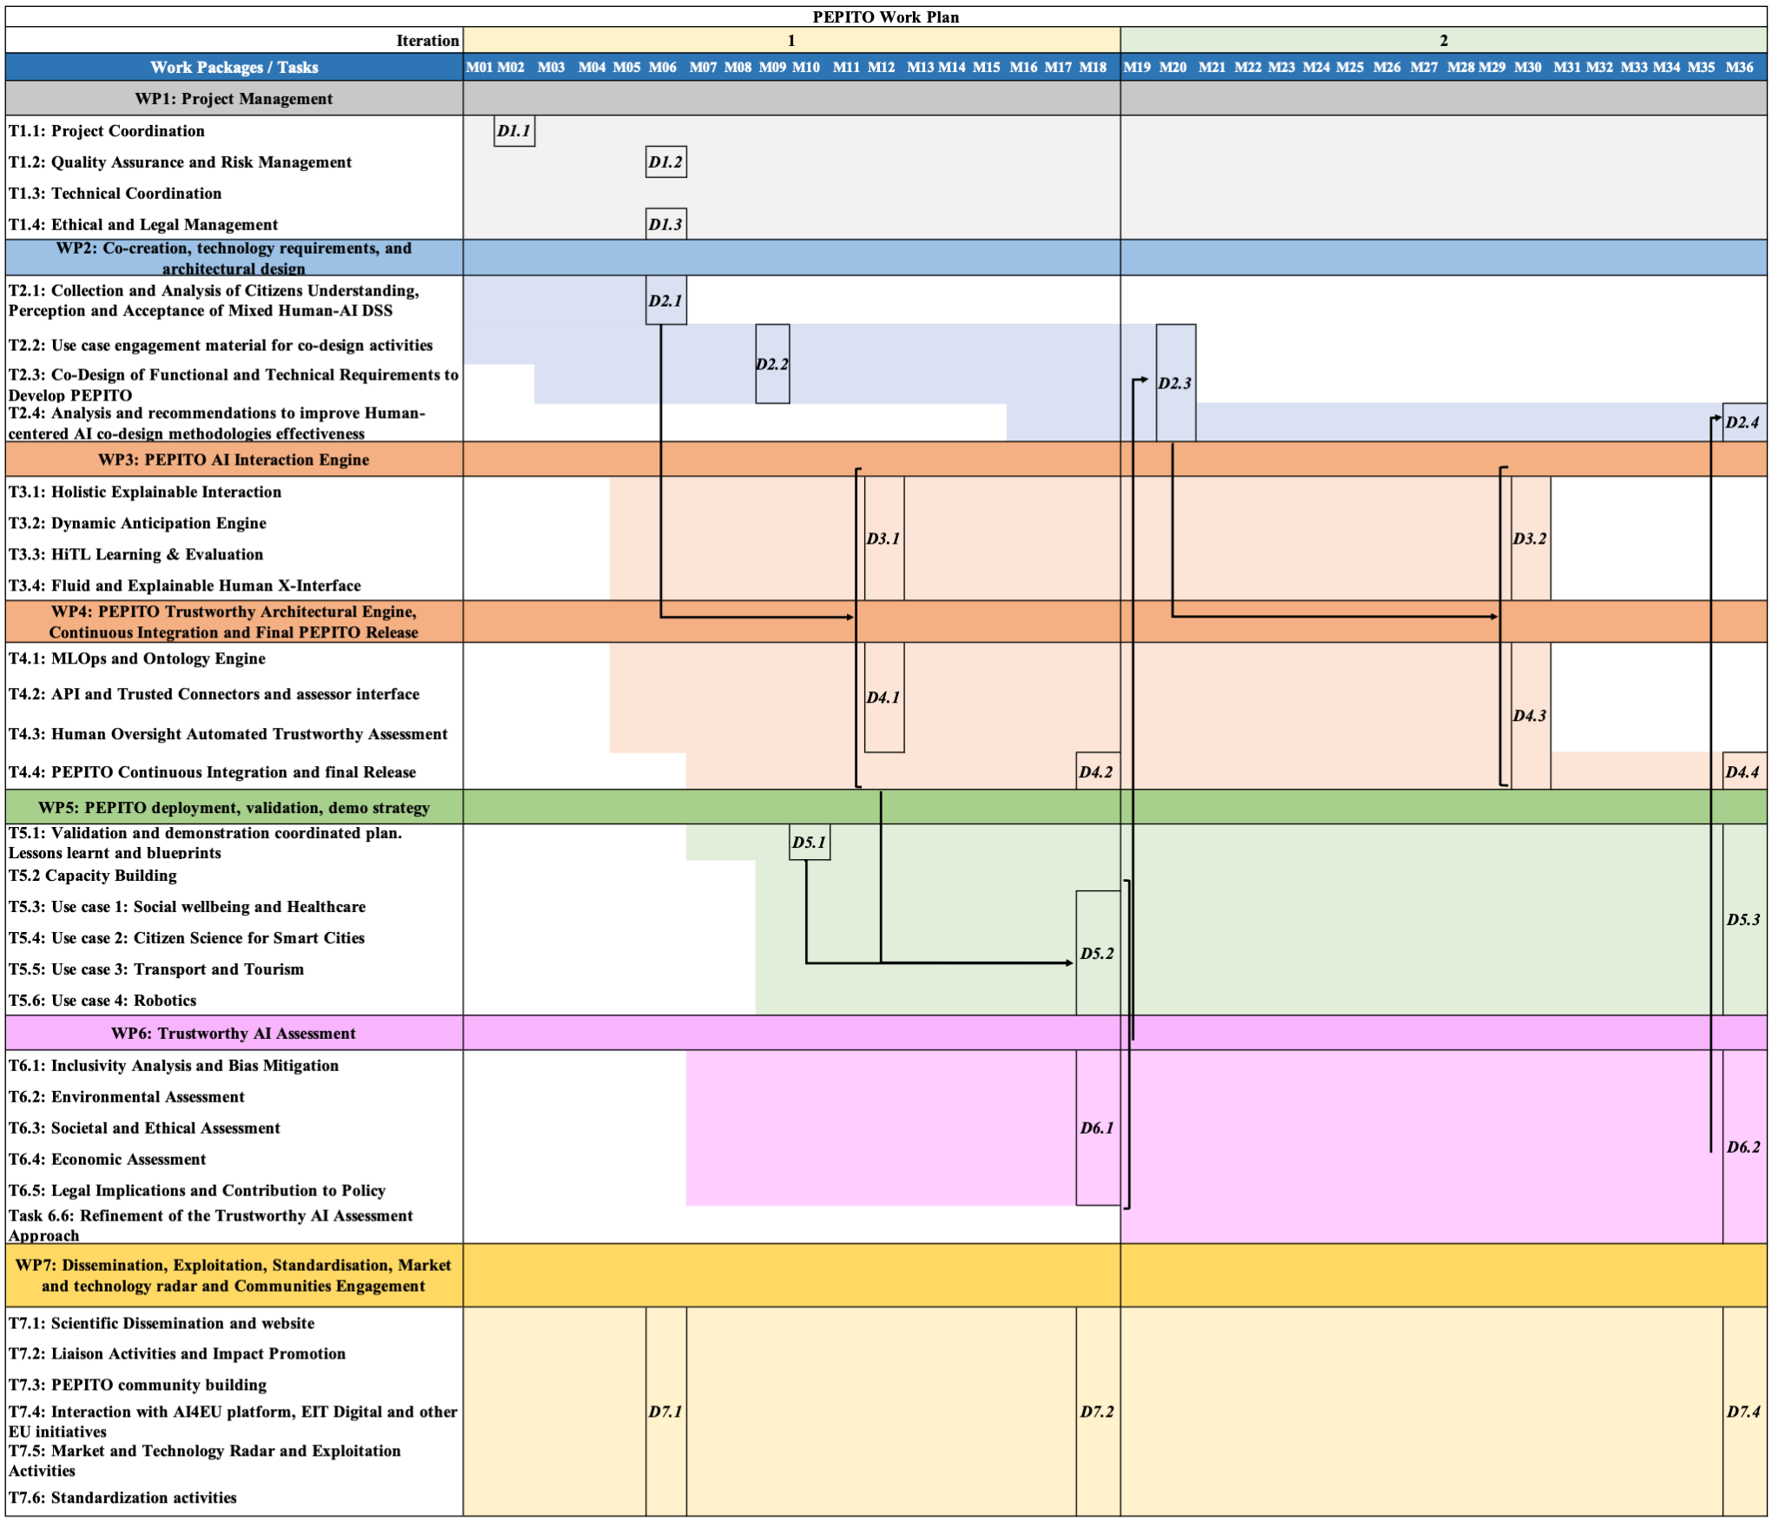
Julia Palma
julia.palma@ucd.ie
Logic Map
and Work Plan
Evaluators will check coherence
(credibility / suitability)
Impacts must be supported with related activities and budget

Slide 27

Julia Palma
julia.palma@ucd.ie
Defining Impact inspired by the EIT KPIs
1. Innovation & Knowledge Outputs
How research turns into usable solutions
New products, services and processes
Patents and other intellectual property
Innovations introduced to the market
2. Business Creation & Economic Impact
How ideas generate growth and jobs
Start-ups created and supported
Scale-ups accelerated
Investment attracted (public and private)
Jobs created
3. Education & Human Capital
How people become future innovators
Students trained and graduates produced
Development of entrepreneurial and innovation skills
Capacity building for professionals and researchers
4. Networks, Diffusion & Ecosystem
How impact spreads across Europe
New partnerships between academia, industry and society
Geographical reach of innovations
Dissemination of results to users, professionals and citizens
5. Societal & Systemic Impact
How innovation improves society and policy
Uptake of solutions addressing societal challenges
Deployment of solutions in real environments
Influence on policy, practices and behaviour
Cross-Cutting Strategic Dimensions
What ensures sustainable long-term impact
Regional innovation and inclusion
Gender balance and diversity
Long-term monitoring of results beyond project end
Source: Adapted from EIT Impact Framework 2022 – 2027 https://www.eit.europa.eu/library/eit-simplified-impact-framework

Slide 28
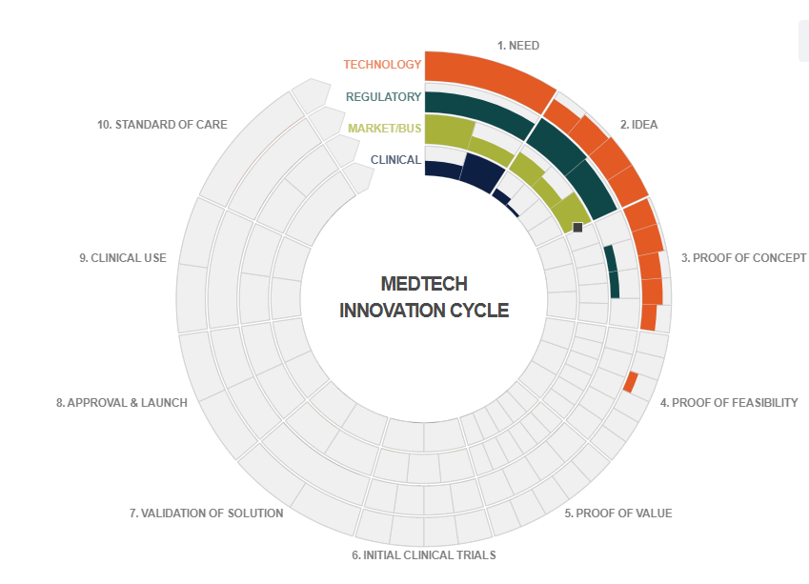
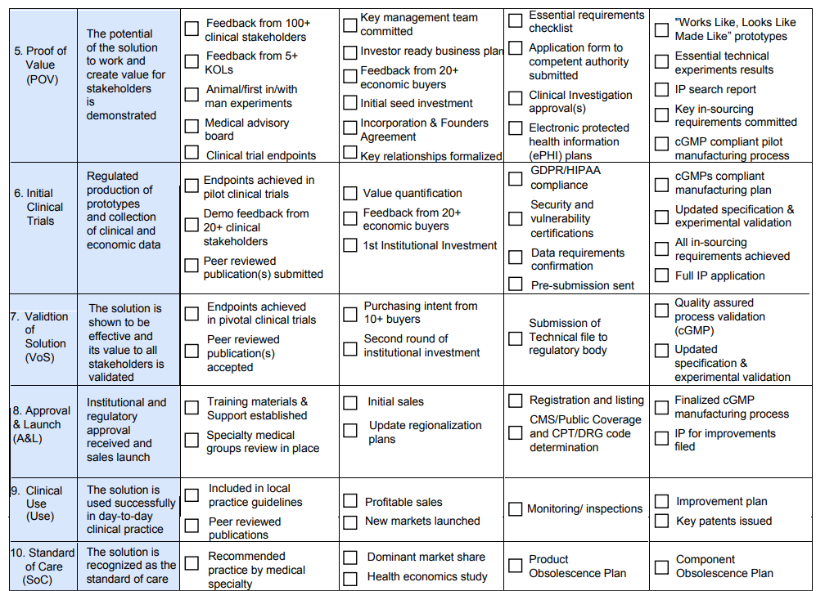
Julia Palma
julia.palma@ucd.ie
Defining Impact
inspired by the CIMIT GAITS
Source: CIMIT Guidance and Impact Tracking System (GAITS) https://www.gaits.org/

Slide 29
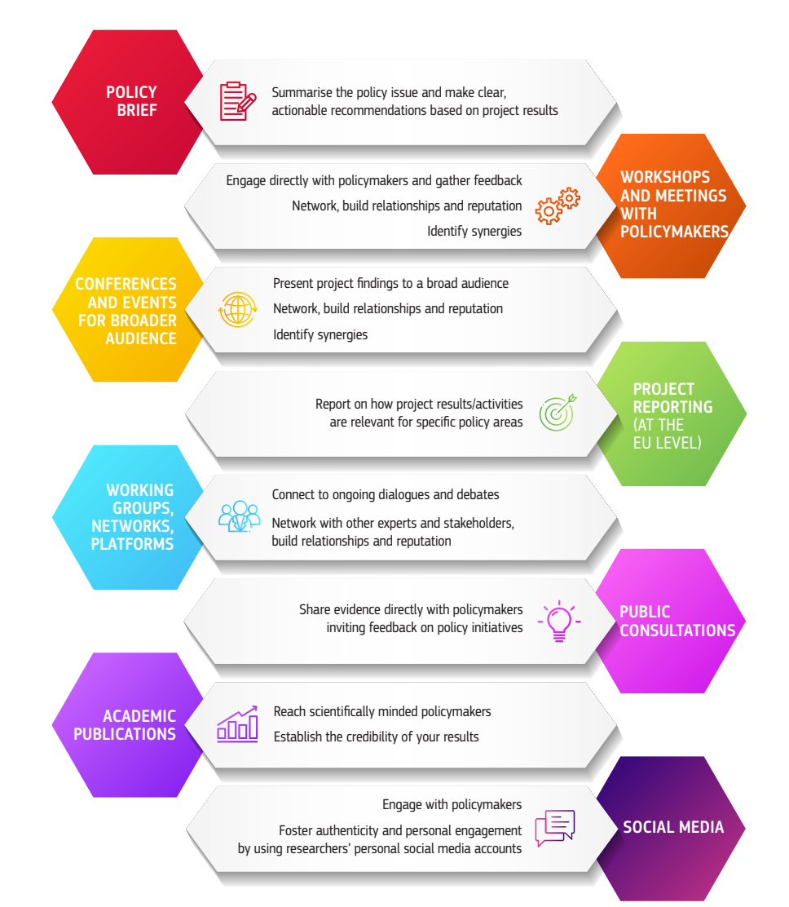
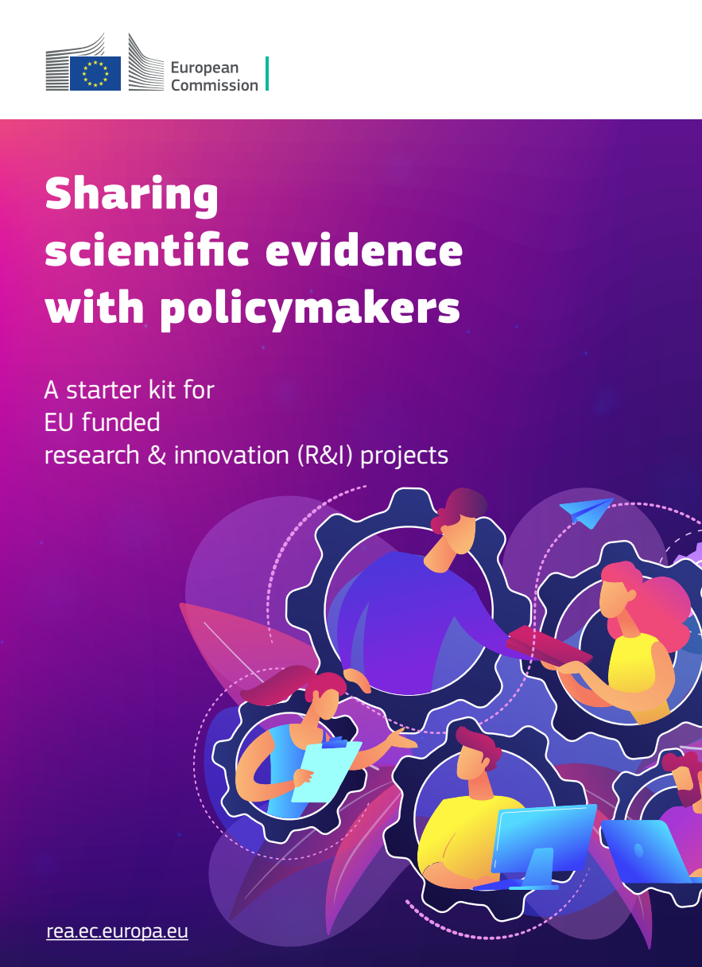
Julia Palma
julia.palma@ucd.ie
Impact on Policy
Source: Sharing scientific evidence with policy makers. A starter kit for EU-funded research and innovation projects (European Commission, 2025, DOI 10.2848/8625431)

Slide 30
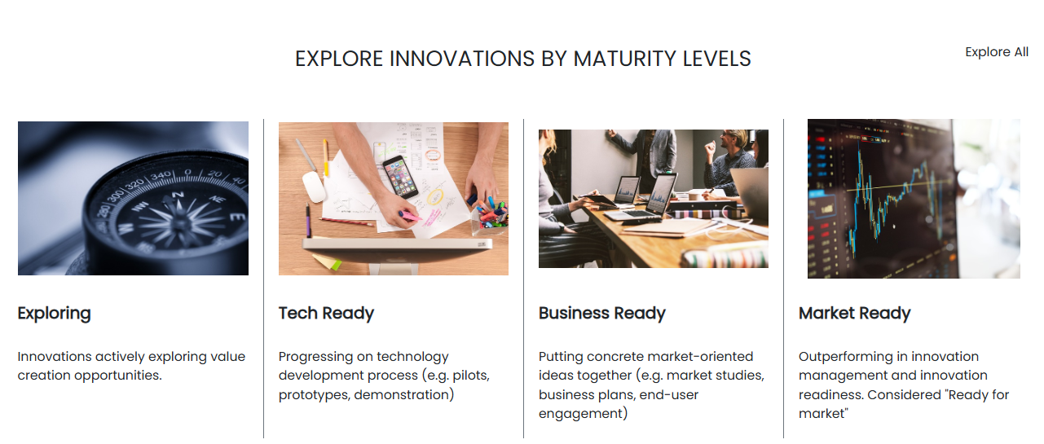
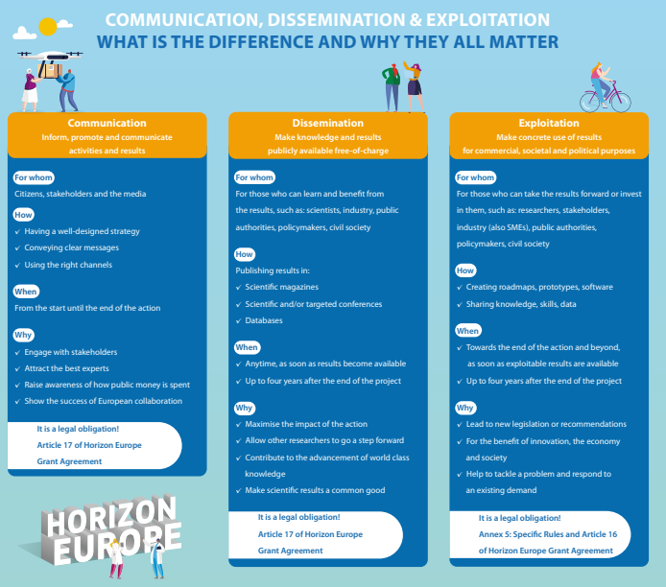
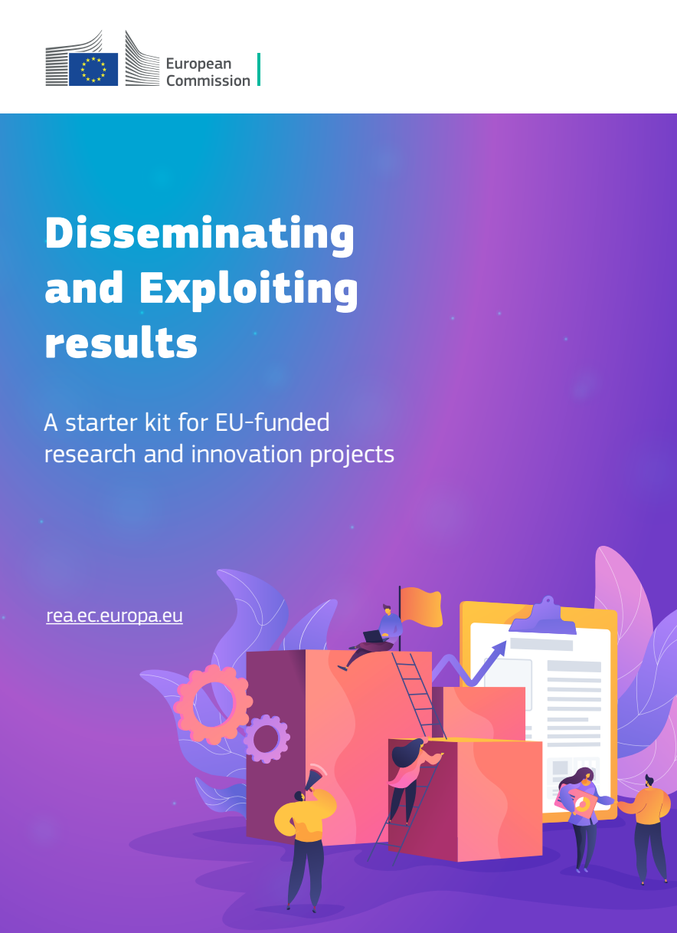
Julia Palma
julia.palma@ucd.ie
EU EC Resources
Innovation Radar https://innovation-radar.ec.europa.eu/
European Commission: European Research Executive Agency, Communication, dissemination & exploitation what is the difference and why they all matter, Publications Office of the European Union, 2023 https://data.europa.eu/doi/10.2848/289075 European Commission: European Research Executive Agency, Disseminating and exploiting results – A starter kit for EU-funded research and innovation projects, Publications Office of the European Union, 2025 https://data.europa.eu/doi/10.2848/1949672

Slide 31
Julia Palma
julia.palma@ucd.ie
Common Impact Killers
Common Drawback | Evaluator Comment | How to Fix It
1. Generic Pathways (e.g., "We will engage with policy-makers and industry.") | "The proposal fails to identify specific stakeholders or explain how engagement leads to adoption." | Name specific organizations (e.g., companies, hospitals…), associations, networks, or EU working groups. Consider including them as partners.
2. Over-Ambitious Claims (e.g., "This project will solve global climate change.") | "Claims regarding the scale of impact are over-ambitious and lack a credible baseline or calculation." | Focus on significance for a specific target group. Use realistic numbers and a clear baseline.
3. Dissemination = Exploitation (Confusing giving a talk with actual use of results.) | "The plan describes communication activities rather than how results will be used commercially or socially." | Define Use. Explain who will own the result, if it’s open-source, or how it becomes a new service/product.
4. Missing Barriers Analysis (Ignoring hurdles like laws, costs, or trust.) | "The applicants have not addressed potential obstacles to innovation, such as regulatory hurdles or user reluctance." | Include a "Barriers & Mitigations" table. Address the "Why Not Yet?" factor honestly.
5. The "Ghost" Work Plan (Impact claims in Sec 2 aren't in the Sec 3 budget/tasks.) | "Lack of coherence; no specific tasks or deliverables are assigned to ensure the exploitation of results." | Map every Outcome/Result to a specific Deliverable and Task in the work plan. Allocate enough PMs.
6. No Quantifiable KPIs (e.g., "We will improve trust in AI“, “The new process will be more sustainable.”) | "The proposal lacks clear, measurable Key Performance Indicators (KPIs) to track progress toward outcomes." | Use Target Numbers: "Increase adoption rate by 15%" or "Input provided to 2 specific standards committees“. Evaluate baseline and think how to measure progress.
7. Weak IP Strategy (e.g., "We will decide on IP during the project.") | "Management of Intellectual Property is insufficiently addressed, risking the sustainability of results." | State existing and new IP and specify access rights for partners, TTO support and potential protection mechanisms (publications, patents, licenses…)
Avoid this Evaluator Traps

Slide 32
Julia Palma
julia.palma@ucd.ie
"Impact-by-design" EU Proposal Checklist
1. The Strategic Foundation (The "Why")
[ ] Policy Alignment: Have you identified the specific EU policy goals (e.g., Green Deal, Digital Decade, AI Continent Plan) your project supports?
[ ] Outcome vs. Impact: Are the Outcomes (short-term benefits) clearly distinguished from your Impacts (long-term societal/economic shifts)?
[ ] The "Why Not Yet?": Have you clearly defined the "barriers" (legal, social, or technical) that currently prevent this impact from happening?
2. Designing the Pathway (The "With Whom")
[ ] Stakeholder Mapping: Have you listed the specific groups (SMEs, policy-makers, citizens) who will actually use your results?
[ ] Credibility Check: Is the pathway realistic? (Avoid "hype"; focus on how you will bridge the gap between your lab and the end-user).
[ ] Negative Side-Effects: Have you identified any potential risks or unintended negative impacts of your research and how to mitigate them?
3. Maximizing Results (The "How")
[ ] The 3 Pillars: Do you have distinct plans for:
Communication: Reaching the general public, stakeholders and the media?
Dissemination: Reaching the potential beneficiaries?
Exploitation: Ensuring the results are used commercially or invested, by public authorities or socially?
[ ] KER Identification: Have you defined 3–5 Key Exploitable Results (e.g., a software tool, a policy white paper, a training module)?
[ ] IP Management: Is there a clear plan for who owns the IP and how it will be protected to prevent it from being lost (or stolen!)?
4. Coherence & Budget (The "What")
[ ] Cross-Section Consistency: Does every impact claimed in Section 2 have a corresponding activity in the Work Plan (Section 3)?
[ ] Budget Alignment: Is there a dedicated budget and "Person Months" allocated to impact, communication, and exploitation activities?
[ ] Measurability: Do you have KPIs (Key Performance Indicators) to prove to the evaluator that you can track your success?
5. UCD & URMAN Final Polish
[ ] Resource Check: Have you consulted the UCD Impact Toolkit or run your draft by a member of the URMAN group?
[ ] The "Policy Link": Does your proposal highlight how UCD’s research contributes to Ireland’s and Europe’s strategic autonomy and priorities?

Slide 33
Julia Palma
julia.palma@ucd.ie
The "Impact Pitch" Test
Can you finish this sentence in 30 seconds?
“My project solves the challenge of [X], creating the result [Y], which will be used by [Z Stakeholders] to achieve the long-term impact of [A]."

Slide 34

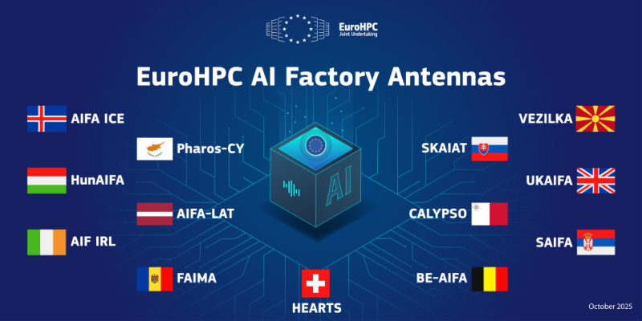
Start with Impact Today, Lead the Research of Tomorrow
Julia PALMA
CeADAR
Programme Manager
julia.palma@ucd.ie
Views and opinions expressed are however those of the author(s) only and do not necessarily reflect those of the European Union or the European Commission as the granting authority. Neither the European Union nor the granting authority can be held responsible for them

